Slide 1
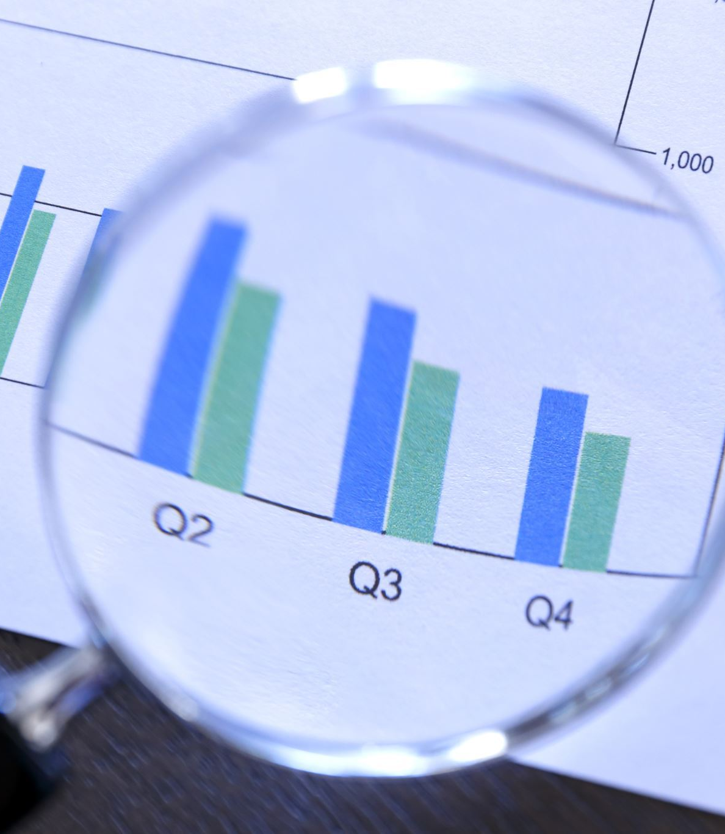
Covid Data Analysis
.

Slide 2
Made By
Rishabh Singh (22m0762)
Ayush Kumar Singh(22m0793)

Slide 3

Description
To make covid data easier for the human brain to grasp and draw conclusions from, we have made this project by putting information into a visual context I.e. graph. The main objective of this project is to make it simpler to spot patterns, trends, and outliers in big data sets.

Slide 4

Achievement
We have analyzed the dataset and plotted different types of graphs to help visualize the data in a simple way. To make things easier we made a webpage and put all the graphs with explanation

Slide 5

Possible Future Work
We can make a mobile application that can bring data analytics related to Covid-19 right into the hands of the ordinary user. It can assist users in staying informed and current on the spread of Covid-19 and related issues at all times and even when they're on the run. Therefore, our work may persuade others to submit comparable applications to aid in our joint fight against the Covid-19 pandemic.

Slide 6
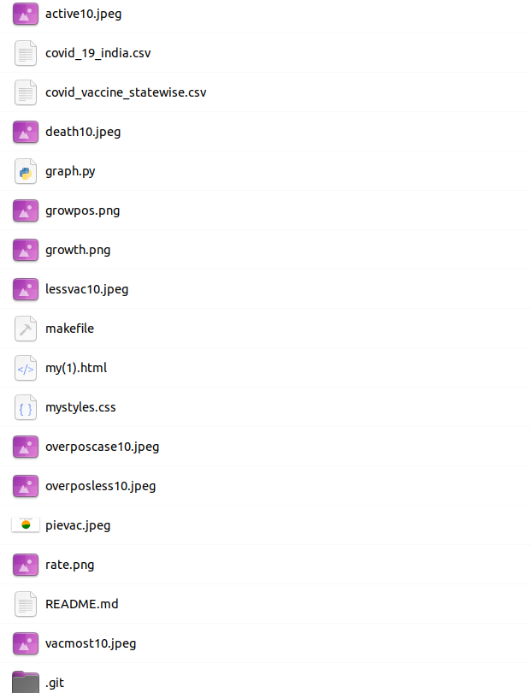
Directory Structure

Slide 7
Library and Functions Used
CSV – Used this library to read and access data
Matplotlib.pyplot – Used to plot different graphs

Slide 8
Running Instructions
First we have to run makefile by using command in terminal "make".
Now after running make the python file will be executed which will generate the graphs.
Now open html file and we can see all the graphs on the page.

